Slide 1
Radio Frequency Signal Generator
By: Ethan Cura, Abel Gonzalez, Joseph Hinz and James Taylor
Notes:
James

Slide 2
Purpose
The goal of this project is to supplement the existing market with a low-cost RF signal generator for students and enthusiasts.
Notes:
James

Slide 3
Technical Summary
The signal generator will have a frequency range between 1 and 128MHz with 1Hz precision.
The signal generator will have a power range of –40 to 10dbm with 1dbm precision.
The signal generator will minimize any spurious signals for a spectrally pure sinusoidal output.
Notes:
Abel

Slide 4
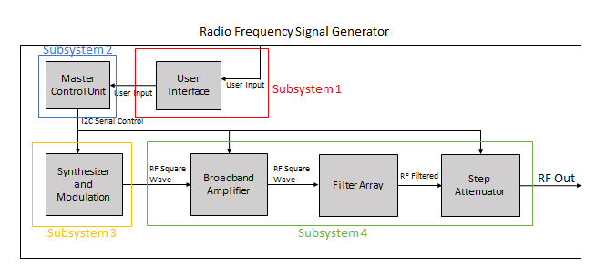
System Overview
Notes:
Ethan

